Slide 1



Project on
Exploratory Data Analysis of Soil and Environmental Parameters Across Different Crops
Analysing Soil and Environmental Parameters for Effective Crop Recommendation
Shriram A. Giri
Batch : 530

Slide 2



About me
Education
B.A. (Economics) (Completed in 2024) from SRTMU, Nanded
P.G.D.M (Marketing) (Pursuing) from MIT-SDE, Pune
Why Data Analysis?
Coming from an Economics background, I developed a strong interest in working with data, identifying trends, and solving business problems through analysis. To build my technical skills and transition into the analytics field
Contact
LinkedIn
+91 90218 71581
GitHub

Slide 3
Introduction & Problem Statement
N · P · K
Agriculture depends heavily on soil nutrient levels and environmental conditions such as temperature, humidity, and rainfall.
Different crops have different nutrient and climatic requirements for healthy growth.
Exploratory Data Analysis (EDA) reveals patterns, distributions, and relationships within agricultural data before any modeling is attempted.
This project examines how three soil nutrients (N, P, K) and four environmental factors (temperature, humidity, pH, rainfall) vary across 22 crop categories.
Temp
Patterns &
Insights
EDA
Humidity
Rainfall
pH
Agricultural stakeholders deal with multiple soil and environmental parameters when evaluating crop conditions. Without systematic analysis, it can be difficult to identify which parameters vary significantly across crops and how these variables are related. This project uses data cleaning, statistical analysis, visualization, and EDA techniques to uncover patterns and relationships within agricultural data, providing stakeholders with a clearer understanding of crop-wise characteristics and environmental conditions.
Analysis of Analysis of Soil and Environmental Parameters Across Different Crops | Exploratory Data Analysis
1
Notes:
Quick framing slide. Say: agriculture is fundamentally a data problem — soil chemistry and weather determine what will grow well. Point to the diagram: we have three nutrients and four environmental readings feeding into an EDA process, which is how we surface patterns before jumping to any predictive modeling. Keep this short — under a minute — this is just scene-setting.

Slide 4
Why This Project?
01
Real Agricultural Relevance
02
Multi-Nutrient Interaction
Agriculture underpins food security and rural livelihoods, giving this analysis a genuine, applied domain rather than a synthetic one.
The dataset captures three soil macronutrients — N, P, and K — simultaneously, allowing their joint variation across crops to be explored.
03
Environmental Diversity
04
Well-Suited to a Full EDA Workflow
Temperature, humidity, pH, and rainfall together represent the major climatic drivers of crop suitability, giving EDA a genuinely multi-dimensional dataset.
A clean, fully numeric feature set with one categorical target is ideal for demonstrating the complete univariate → bivariate → multivariate workflow.
Analysis of Analysis of Soil and Environmental Parameters Across Different Crops | Exploratory Data Analysis
2
Notes:
Four reasons this dataset earns a real EDA project rather than being a toy exercise: it's genuinely applied, it has three correlated nutrients to explore, four climate variables, and a clean structure that supports the full univariate-bivariate-multivariate progression the course requires. If faculty push on 'why not a bigger/messier dataset', that's addressed honestly on the next slide.

Slide 5
Dataset Information
DATASET OVERVIEW
2,200 × 8
Dataset name
Crop_recommendation.csv
Dataset source
Kaggle
rows × columns
Number of rows
2,200
Number of Columns
8
DATASET REQUIREMENT NOTE
Numerical Columns
7 (N, P, K, temperature, humidity, ph, rainfall)
The project manual specifies a minimum of 10 columns and approximately 5,000-7,000+ rows. The supplied dataset contains 8 columns and 2,200 rows.
The analysis is nevertheless performed in full on the supplied dataset to demonstrate the complete required EDA workflow. A larger dataset is suggested as future work (see Conclusion).
Categorical Columns
1 (label)
Target Columns
label — crop category (22 classes)
Analysis of Analysis of Soil and Environmental Parameters Across Different Crops | Exploratory Data Analysis
3
Notes:
Straightforward inspection slide, all figures pulled directly from df.shape and dtype checks. The one thing to flag proactively: the manual asked for a bigger dataset (10+ columns, 5-7k+ rows) and this one is smaller — 8 columns, 2,200 rows. Be upfront about that, note it's called out clearly rather than hidden, and that the full workflow is still demonstrated properly on the data we do have. If asked, the fix is simply 'use a larger dataset next time' — mentioned again in the conclusion.

Slide 6
Understanding the Dataset
Column | Type | Role | Description
N | Numerical (int) | Feature | It Represents Nitrogen content in soil (kg/ha)
P | Numerical (int) | Feature | It Represents Phosphorus content in soil (kg/ha)
K | Numerical (int) | Feature | It Represents Potassium content in soil (kg/ha)
Temperature | Numerical (float) | Feature | It Represents Ambient temperature (°C) of the Area
Humidity | Numerical (float) | Feature | It Represents Relative humidity (%) of the Area
pH | Numerical (float) | Feature | It Represents Soil pH value
Rainfall | Numerical (float) | Feature | It Represents Rainfall (mm) of a specific area
Label | Categorical (string) | Target | It Represents Recommended crop category (22 classes / Crops)
"label" represents the crop that is agronomically suited to the corresponding combination of soil nutrients and environmental conditions in each row — it is the categorical target variable around which the bivariate and multivariate analysis is organized.
Analysis of Analysis of Soil and Environmental Parameters Across Different Crops | Exploratory Data Analysis
4
Notes:
Walk through the table briefly rather than reading every row: seven numeric features — three nutrients (N, P, K) and four environmental readings — plus one categorical target, label, which holds 22 crop names. Emphasize the Feature/Target split since that's the axis the rest of the deck is organized around.

Slide 7
Data Cleaning & Preparation
Shape verified
✓
Missing values checked
✓
0 missing values found — no imputation required
2,200 rows × 8 columns confirmed with df.shape
✓
Column names checked
✓
Duplicates checked
N, P, K, temperature, humidity, ph, rainfall, label
0 duplicate rows found — no rows removed
✓
Standardized to lowercase
✓
Outliers analyzed (IQR method)
n, p, k, temperature, humidity, ph, rainfall, label — N/P/K kept in chart labels as standard nutrient symbols
Notable in P, K, rainfall, temperature — see chart
✓
Data types verified
✓
Class balance checked
3 integer columns, 4 float columns, 1 categorical column
Perfectly balanced — 100 records per crop (22 classes)
Analysis of Analysis of Soil and Environmental Parameters Across Different Crops | Exploratory Data Analysis
5
Notes:
This is the core data-quality slide. Walk the checklist quickly on the left — shape, column names, lowercase standardization, dtypes, then the two clean results: zero missing values and zero duplicates, so say explicitly that no imputation or de-duplication was needed. Spend more time on the right: the boxplots show real outliers in P, K, rainfall and temperature. The key finding — if faculty ask 'why didn't you remove them' — is that when you trace the K outliers back to their crop labels, all 200 of them are apple or grapes, which really do need roughly 200 kg/ha of potassium versus under 85 for everything else. That's a genuine agronomic signal, not noise, so it was kept.

Slide 8
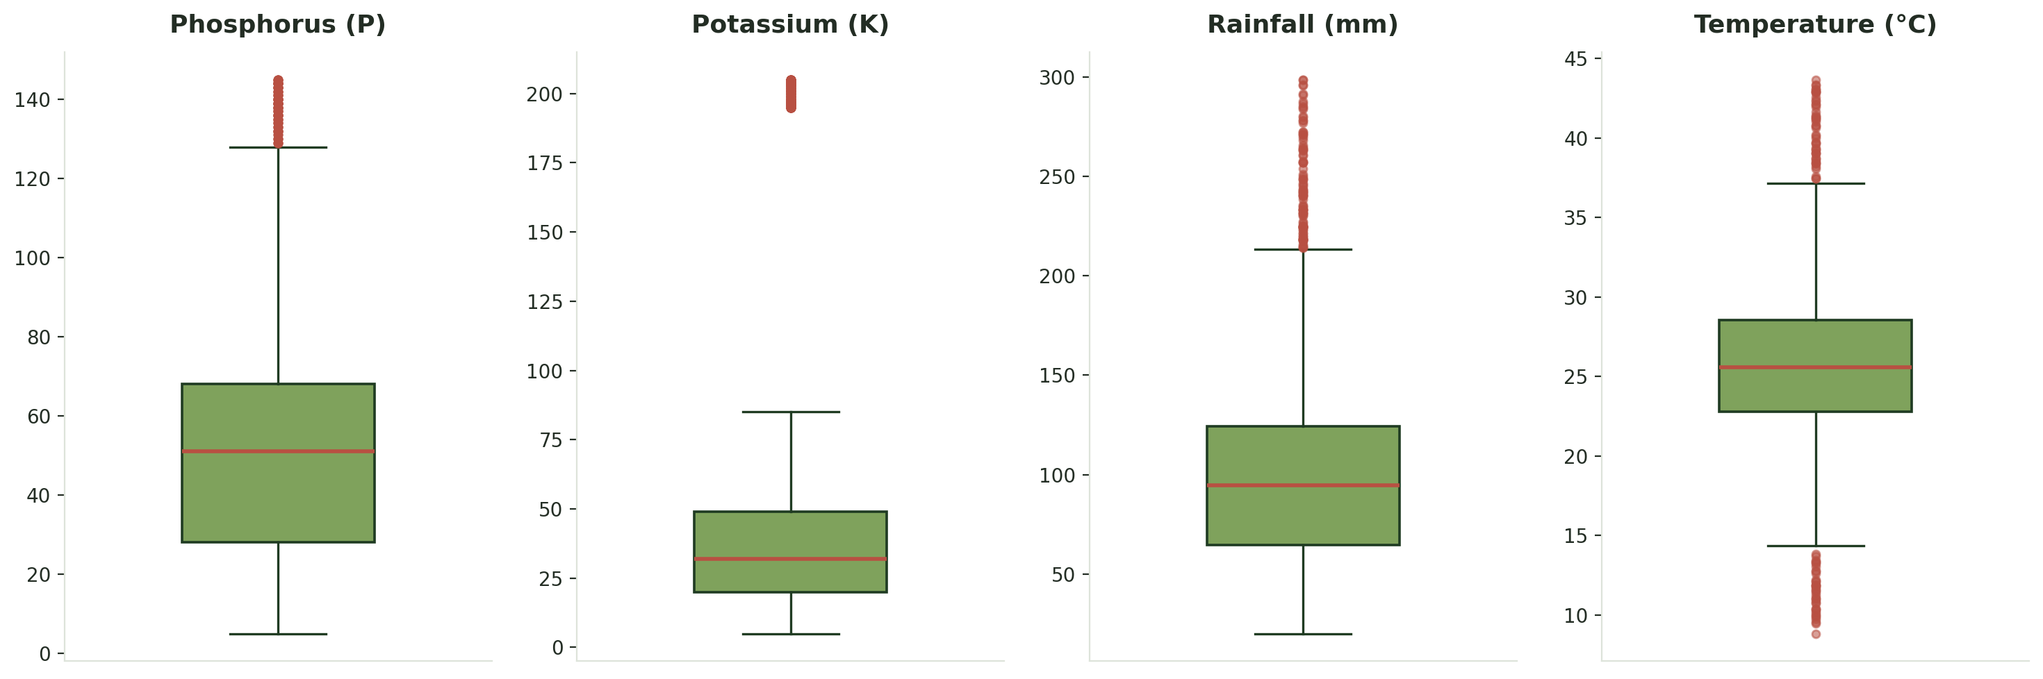
Understanding Outliers
Total Outliers – 432
(P, K, rainfall, temperature)
Observation: P (6.3%), K (9.1%), rainfall (4.6%) and temperature (3.9%) show values beyond the IQR whiskers.
Interpretation: Nearly all K outliers (200/200) and most P outliers trace back to apple and grapes, which genuinely require far higher potassium and phosphorus than other crops. Rainfall outliers are concentrated in rice; temperature outliers in papaya, grapes and orange.
Decision: All 432 outliers were retained — they reflect real crop-specific agronomic variation, not data-entry errors.
Analysis of Analysis of Soil and Environmental Parameters Across Different Crops | Exploratory Data Analysis
6

Slide 9
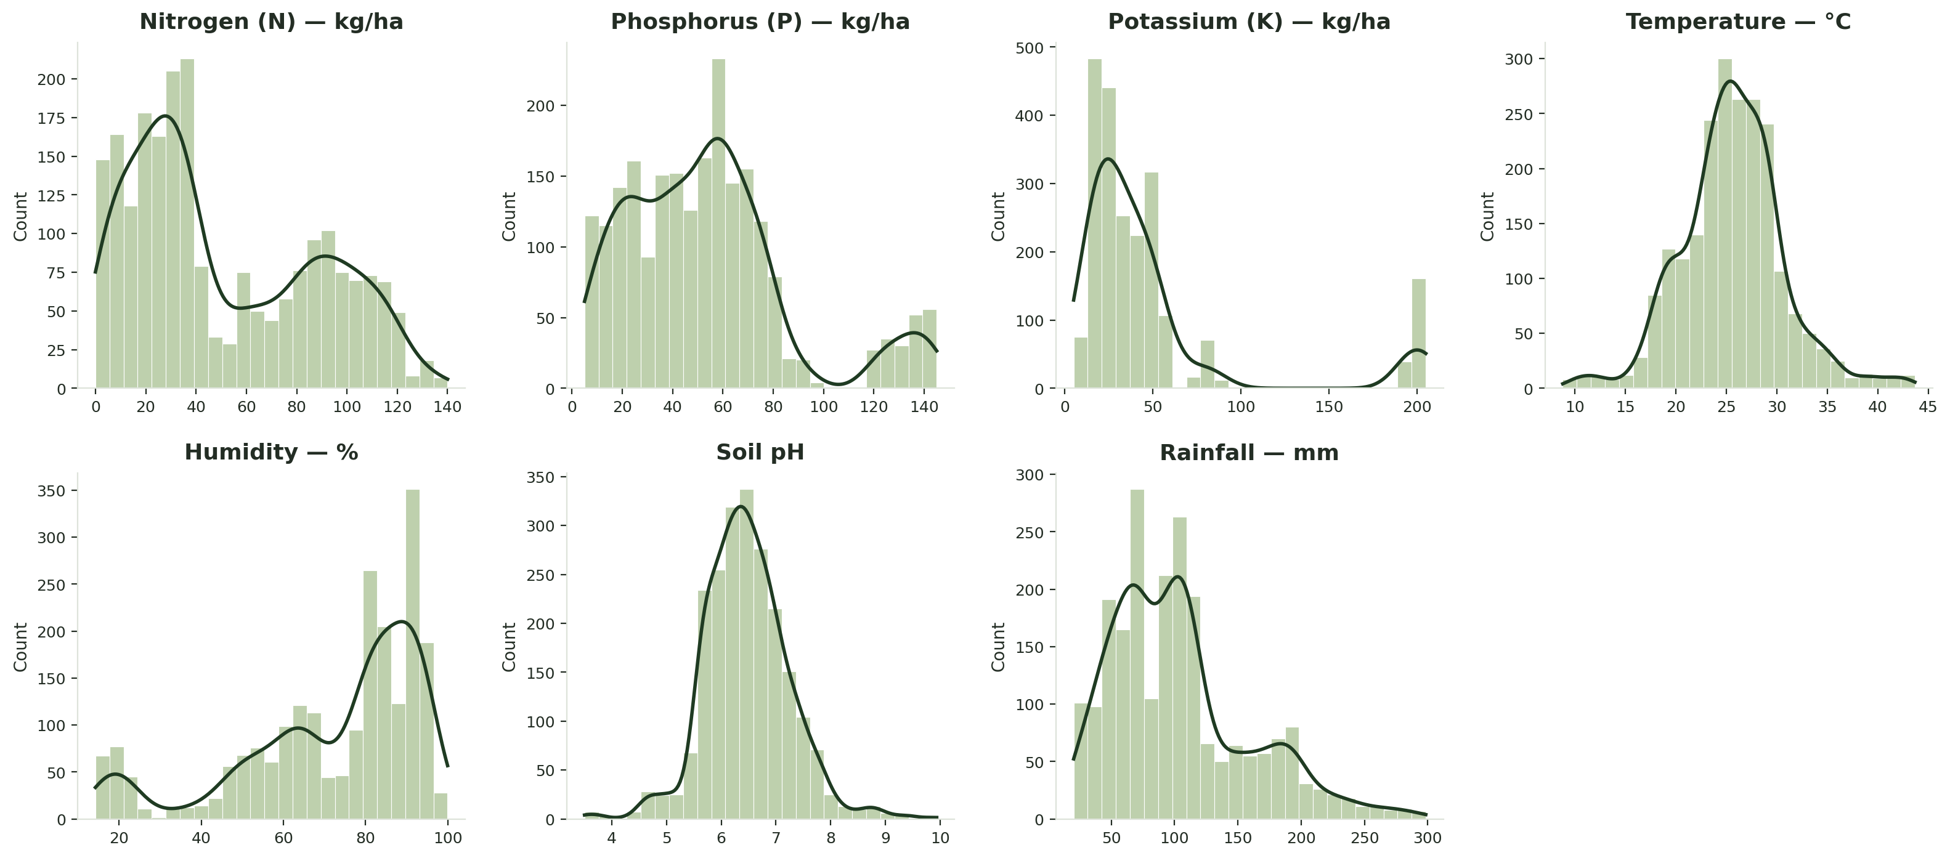
Univariate Analysis
Distribution shape: N, P and rainfall are right-skewed with a secondary cluster at high values; K is sharply right-skewed with an isolated high cluster near 200 (the apple/grapes group); temperature and pH are roughly bell-shaped; humidity is left-skewed, concentrated above 80%. Target class: All 22 crops have exactly 100 records each — the target variable is perfectly balanced (see checklist, previous slide).
Analysis of Analysis of Soil and Environmental Parameters Across Different Crops | Exploratory Data Analysis
7
Notes:
Two charts here answer 'what does each variable look like on its own'. The histogram grid: point out K's isolated bump near 200 — that's the apple/grapes group again, same story as the outlier slide. N, P and rainfall are right-skewed with a secondary high cluster; temperature and pH look roughly normal; humidity is left-skewed, piled up above 80%. The bottom chart is the categorical variable, label — every one of the 22 crops has exactly 100 rows, so this dataset needs no class-balancing before any further analysis.

Slide 10
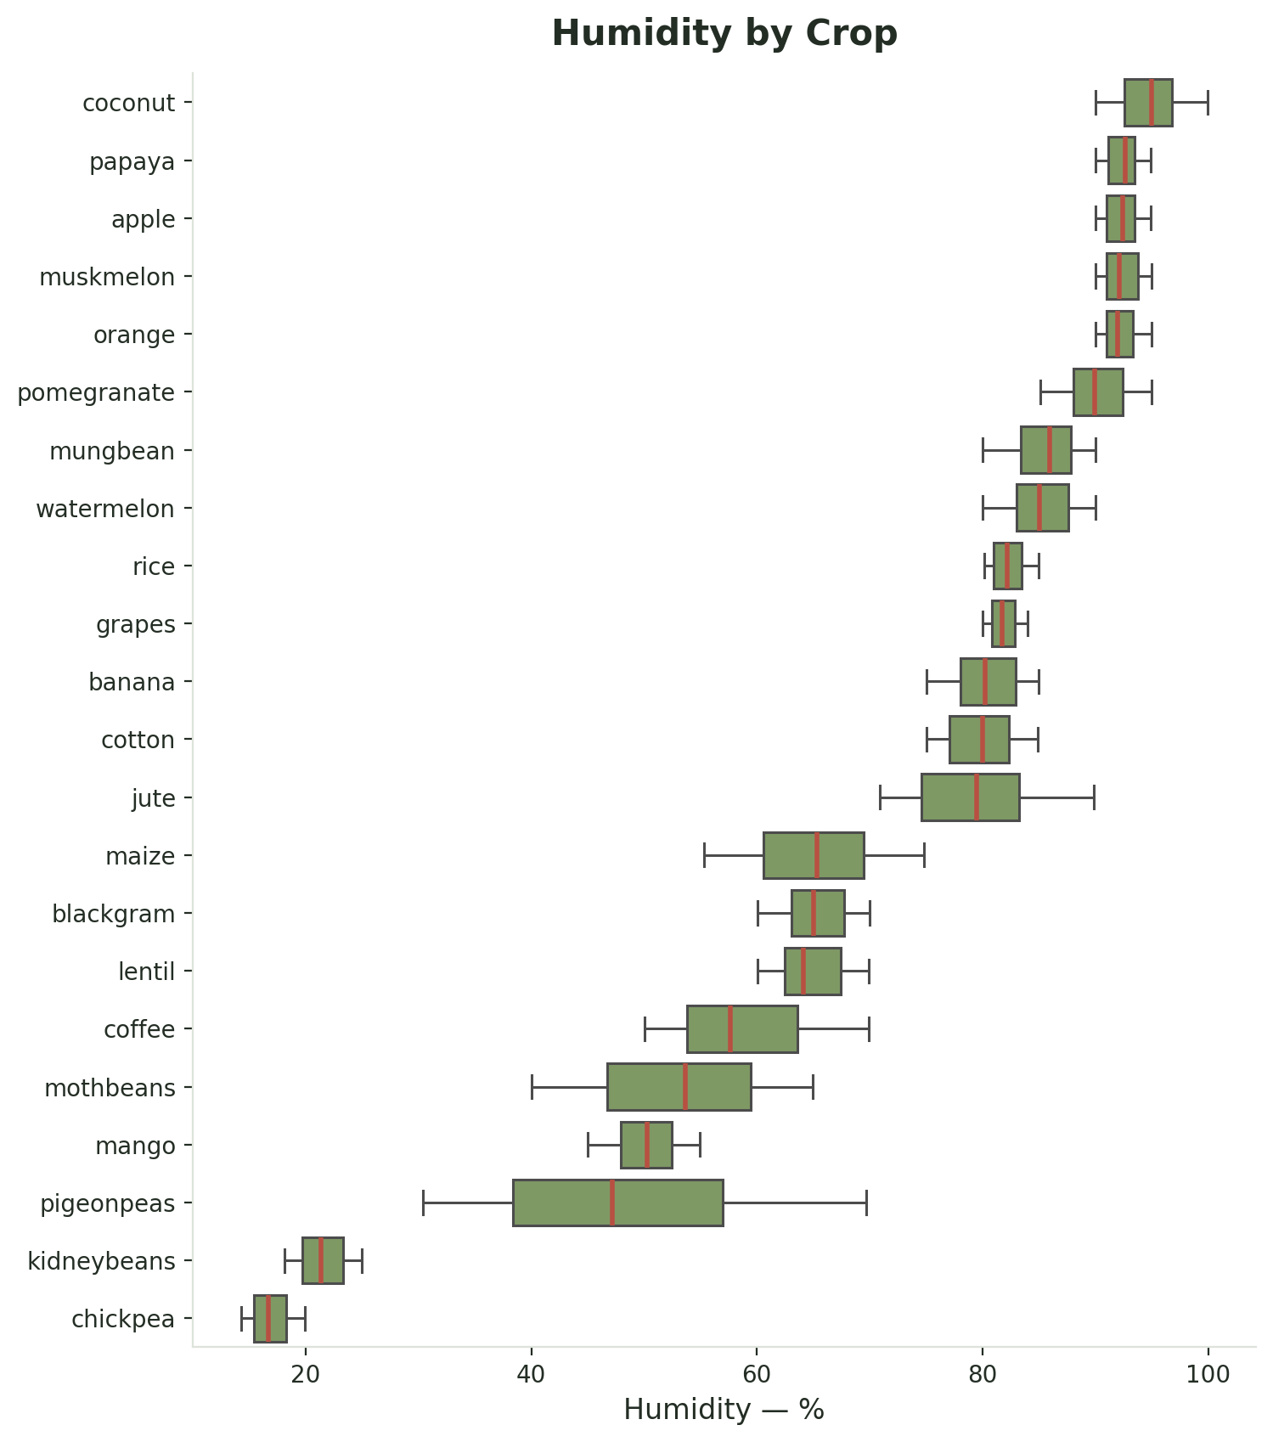
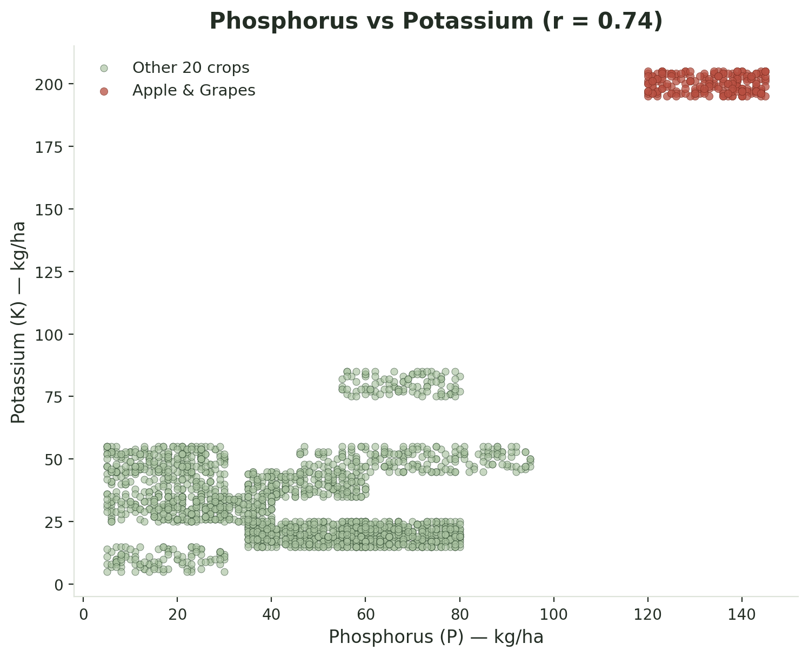
Bivariate Analysis
Phosphorus vs Potassium: The strongest numeric relationship in the dataset (r = 0.74). A scatter plot was chosen because it directly shows the shape of a numeric-numeric relationship. Apple and grapes form a completely separate high-P, high-K cluster from the other 20 crops.
Humidity by crop: Coconut and papaya cluster above 90% humidity, while chickpea and kidney beans sit below 22% — a clean categorical-numeric split. (Temperature vs humidity, r ≈ 0.21, was also examined but is weaker and not shown here.)
Analysis of Analysis of Soil and Environmental Parameters Across Different Crops | Exploratory Data Analysis
8
Notes:
Two relationships, one numeric-numeric and one categorical-numeric, chosen to show the range of bivariate techniques. Left: Phosphorus vs Potassium — the strongest correlation in the whole dataset at r = 0.74, and the scatter makes it visual: apple and grapes sit completely apart from the other 20 crops in the top-right. Right: humidity by crop — coconut and papaya cluster above 90%, chickpea and kidney beans sit below 22%, a clean categorical-numeric split. A weaker pair, temperature vs humidity (r ≈ 0.21), was also examined but isn't shown here since it added little beyond what's already covered.

Slide 11
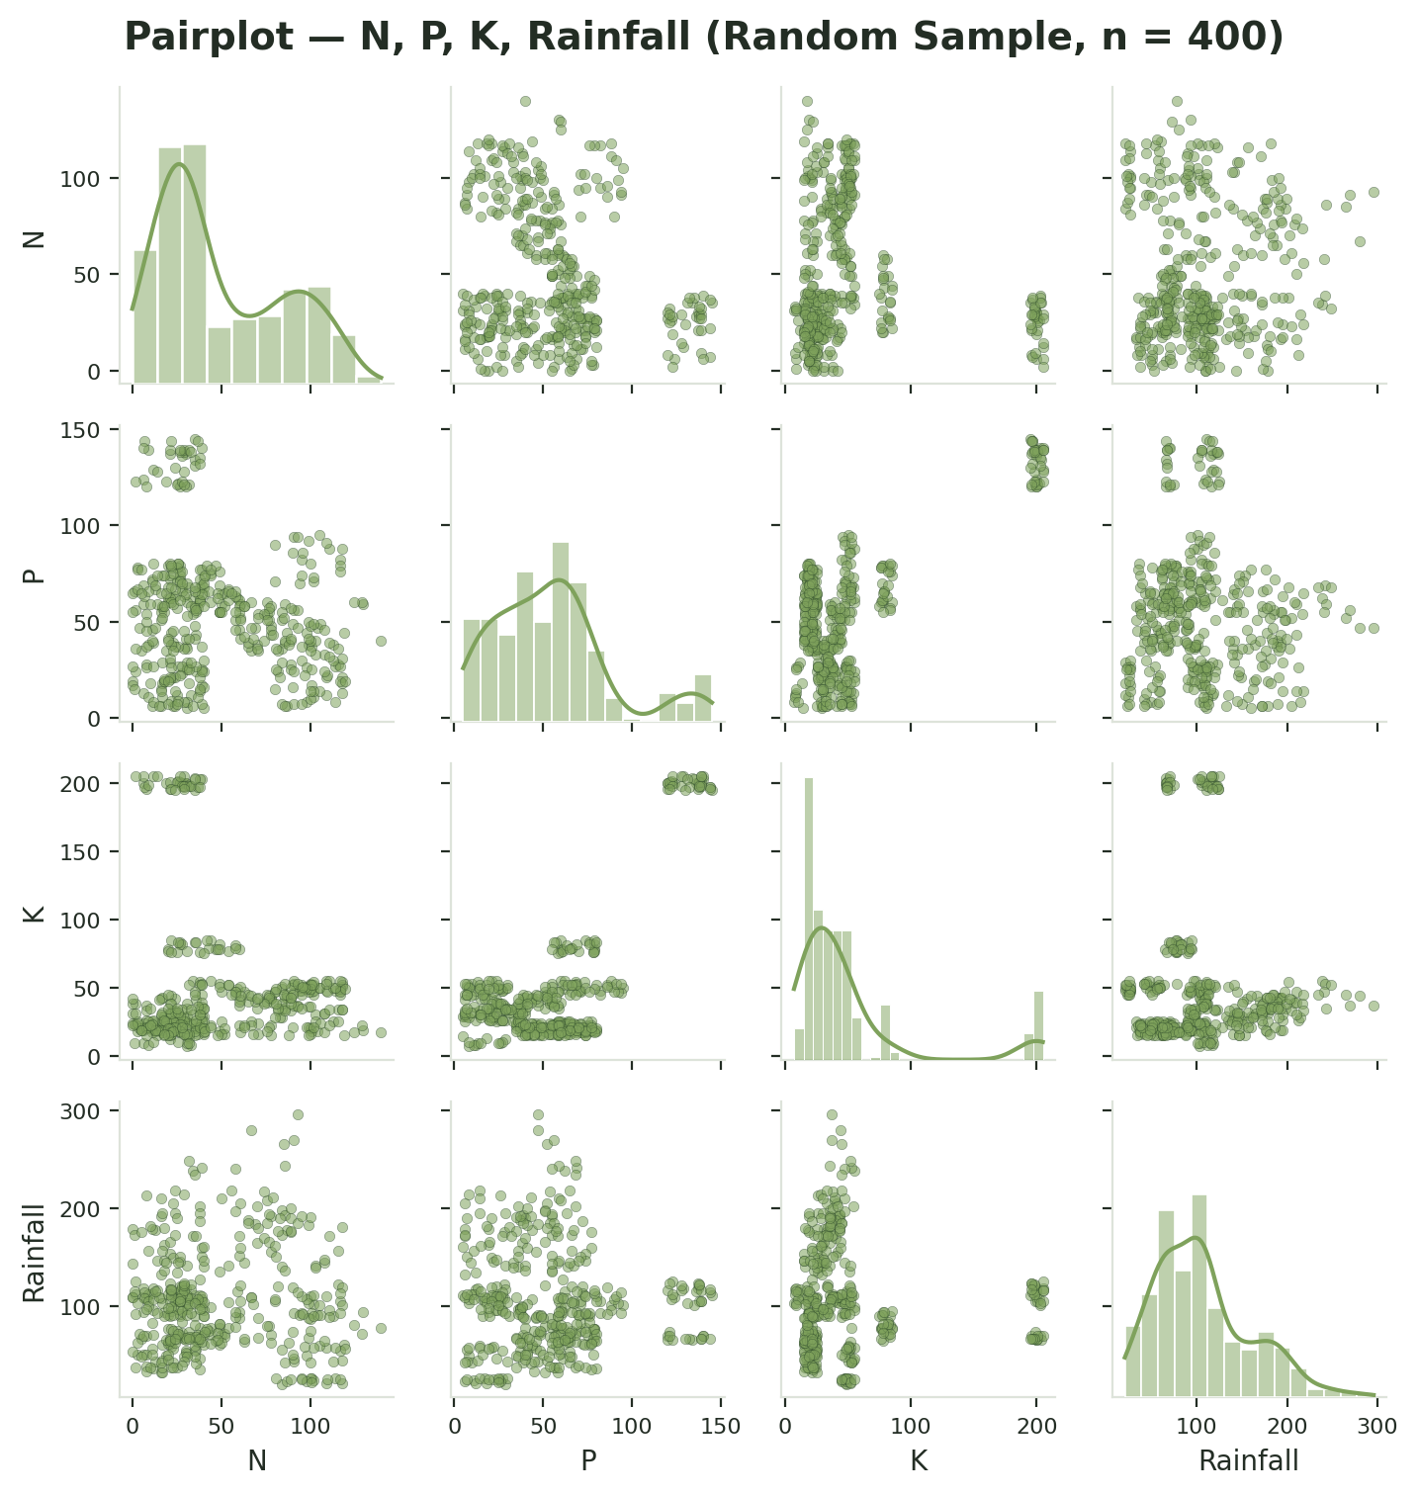
Multivariate Analysis
P-K is the only strong relationship (r = 0.74); all other pairs are weak (|r| < 0.25). Pairplot uses a random sample of 400 of the 2,200 records for visual clarity; patterns are consistent with the full dataset. Correlation indicates association, not causation.
Analysis of Analysis of Soil and Environmental Parameters Across Different Crops | Exploratory Data Analysis
9
Notes:
Heatmap on the left covers all 21 pairwise correlations among the 7 numeric variables at once — P-K at 0.74 is the only strong one, everything else is under 0.25 in magnitude. Pairplot on the right adds N and rainfall into the picture; it's built on a random sample of 400 rows rather than all 2,200 purely so the points don't over-plot into a solid blob — patterns match the full dataset. If faculty ask about causation, the answer is the line at the bottom: correlation is association, not causation, and nothing here claims one variable causes crop choice.

Slide 12
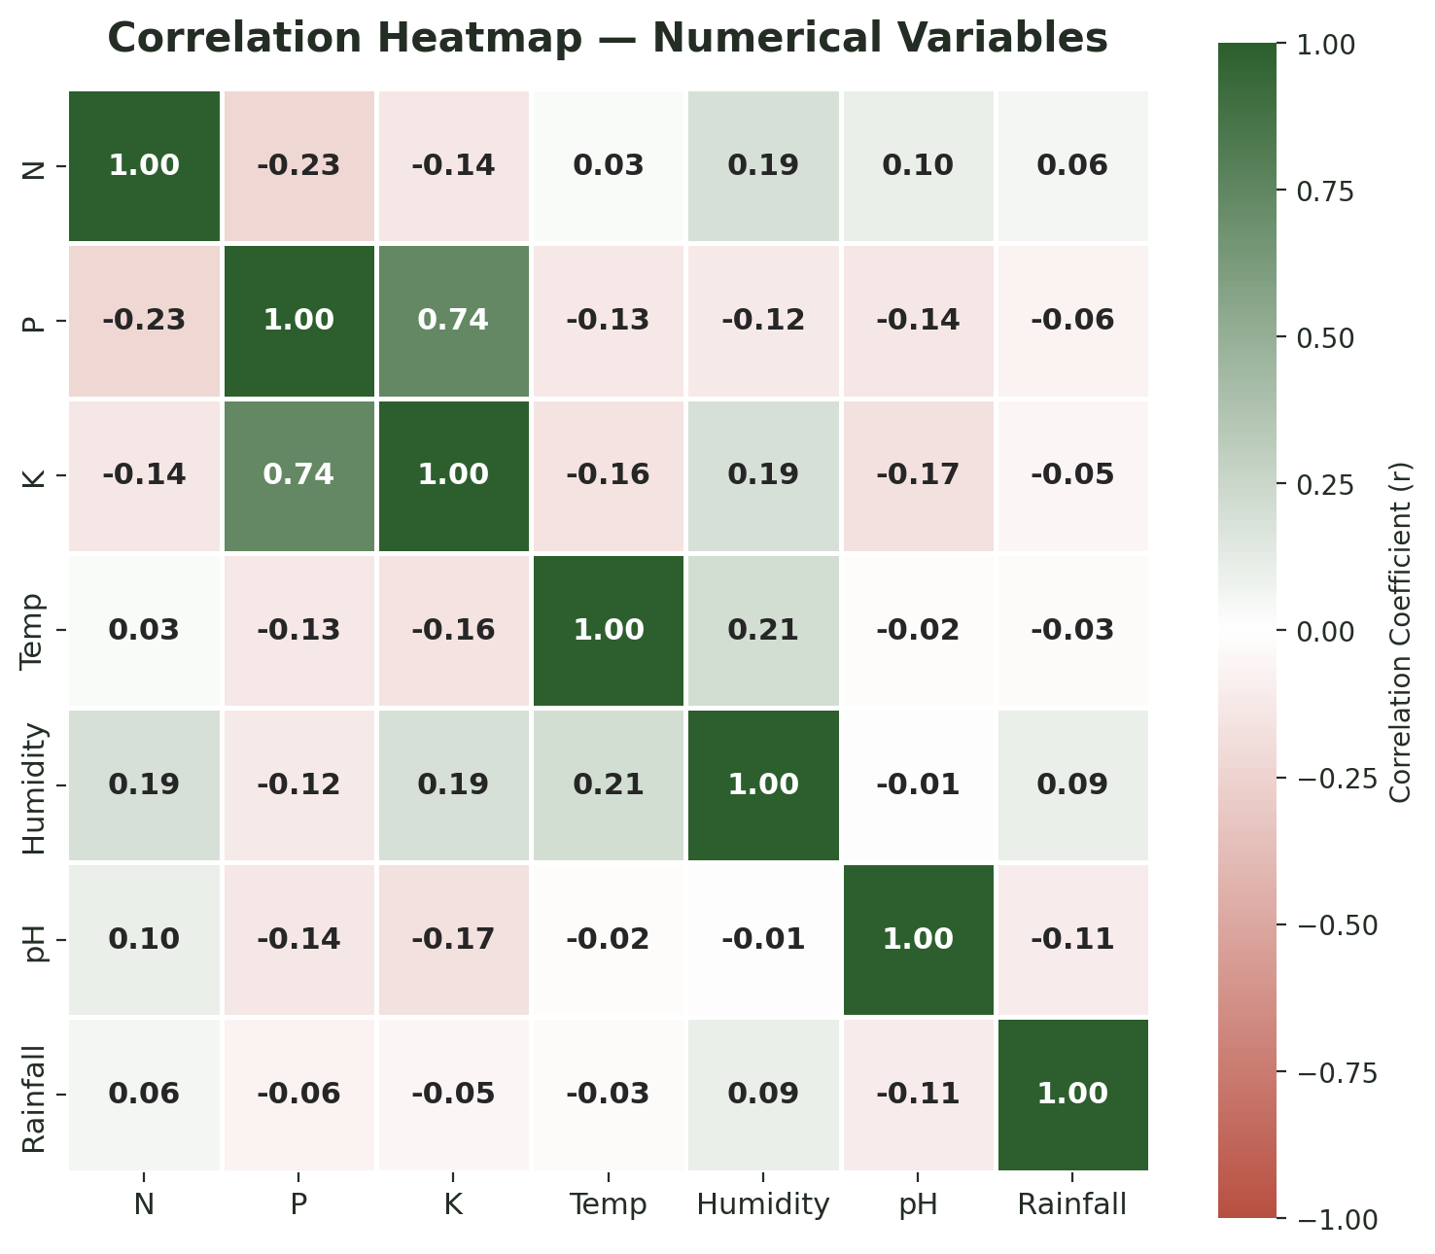
Multivariate Analysis
Strongest Soil Links: Phosphorus (P) and Potassium (K) have a strong positive correlation of 0.74. If a soil sample is high in one, it is highly likely to be high in the other.
Weakest Soil Links: Nitrogen (N) has very little linear relationship with P (-0.23) or K (-0.14).
Weather & Environment: Climate variables like Temperature, Humidity, and Rainfall show almost zero correlation with soil nutrients (all values are close to 0). This means the environmental factors in this dataset do not linearly predict nutrient levels.
Analysis of Analysis of Soil and Environmental Parameters Across Different Crops | Exploratory Data Analysis
10

Slide 13
Pivot Tables & Key Insights
Average N-P-K by Crop (selected)
Average Environmental Conditions by Crop (selected)
Crop | N | P | K
cotton | 117.8 | 46.2 | 19.6
rice | 79.9 | 47.6 | 39.9
chickpea | 40.1 | 67.8 | 79.9
grapes | 23.2 | 132.5 | 200.1
apple | 20.8 | 134.2 | 199.9
lentil | 18.8 | 68.4 | 19.4
Crop | Temp (°C) | Humidity (%) | pH | Rainfall (mm)
rice | 23.7 | 82.3 | 6.4 | 236.2
coconut | 27.4 | 94.8 | 6.0 | 175.7
mango | 31.2 | 50.2 | 5.8 | 94.7
kidneybeans | 20.1 | 21.6 | 5.7 | 105.9
chickpea | 18.9 | 16.9 | 7.3 | 80.1
muskmelon | 28.7 | 92.3 | 6.4 | 24.7
KEY INSIGHTS
Nutrient needs are highly crop-specific: cotton requires far more nitrogen (mean N ≈ 118 kg/ha) than any other crop, while apple and grapes require far more potassium and phosphorus (K ≈ 200 kg/ha, P ≈ 133-134 kg/ha).
Phosphorus and potassium are strongly correlated (r = 0.74) — crops needing high P tend to need high K, most visibly apple and grapes.
Rainfall requirements vary nearly ten-fold across crops, from ~25 mm (muskmelon) to ~236 mm (rice).
Humidity separates crops into distinct bands: coconut and papaya are associated with humidity above 90%, while chickpea and kidney beans sit below 22%.
The target variable is perfectly balanced — 100 records for every one of the 22 crops — so no resampling is needed for further analysis.
Analysis of Analysis of Soil and Environmental Parameters Across Different Crops | Exploratory Data Analysis
11
Notes:
Two compact pivot tables — full versions with all 22 crops live in the notebook, these show a representative selection so the pattern is readable on a slide. Left table: nutrients, ordered to show the spread from cotton's very high nitrogen down to lentil's low nitrogen, with grapes and apple's extreme P/K jumping out. Right table: environmental conditions, showing rice's high rainfall down to muskmelon's low rainfall, and the humidity/pH spread. Then five insights at the bottom — all of them traceable directly back to numbers already shown earlier in the deck, nothing new is asserted here that wasn't already demonstrated.

Slide 14
Conclusion & Learnings
MAJOR EDA FINDINGS
Every crop has a distinct nutrient and environmental “signature” — most sharply visible in apple and grapes (very high P & K) and rice (very high rainfall).
Phosphorus and Potassium are the only strongly correlated pair (r = 0.74) among the 7 numeric variables; all others are weak.
The dataset is clean (0 missing values, 0 duplicates) and perfectly balanced (100 records per crop across 22 classes).
Apparent outliers in P, K, rainfall and temperature were traced to specific crops and retained as genuine agronomic variation, not errors.
FUTURE SCOPE
A larger dataset (5,000-7,000+ rows, 10+ columns) to satisfy the manual's scale guideline
Additional fields such as soil type, geographic region, and season
Historical, multi-year agricultural data to check pattern stability
Predictive modeling, only after this exploratory foundation is well established
WHAT THIS PROJECT DEMONSTRATED
A complete, evidence-based EDA workflow — data cleaning → univariate → bivariate → multivariate analysis → pivot tables → insights — where every claim is grounded in an actual calculation on the supplied data, not assumed.
Future scope is a brief closing note, not the focus of this project — the goal here was disciplined, data-grounded EDA.
Analysis of Analysis of Soil and Environmental Parameters Across Different Crops | Exploratory Data Analysis
12
Notes:
Closing slide, mirrors the title slide's dark background to bookend the deck. Four findings on the left recap the strongest, most defensible results — crop-specific nutrient signatures, the one strong correlation, the clean and balanced data, and the outlier decision. Bottom-left is the one-line 'what this demonstrates' statement in case a single summary sentence is needed. Right side is future scope, kept deliberately short — bigger dataset, more fields, multi-year data, and modeling only as a later step once the exploratory work holds up. End here; the appendix slides after this are backup material for Q&A, not part of the core narrative.

Slide 15


THANK YOU

